Slide 1
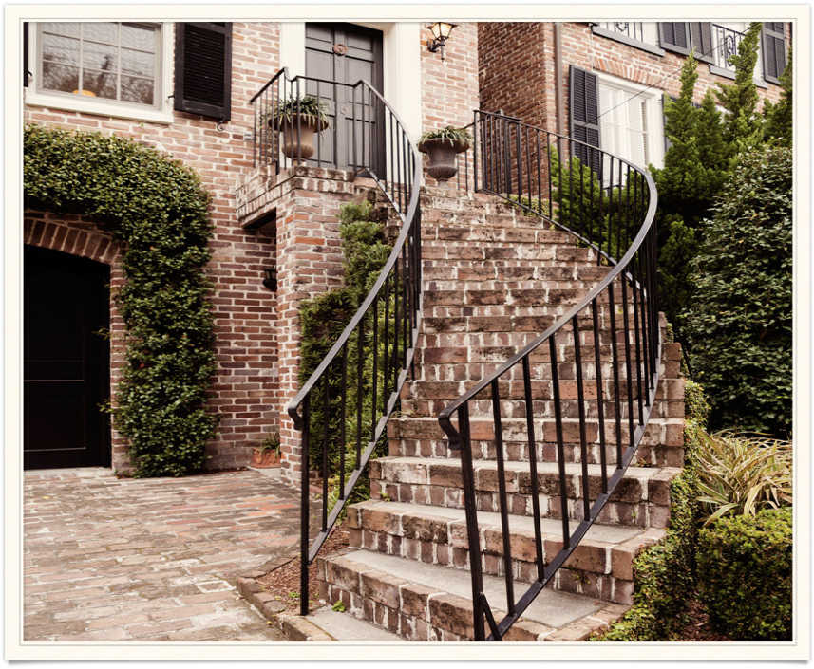
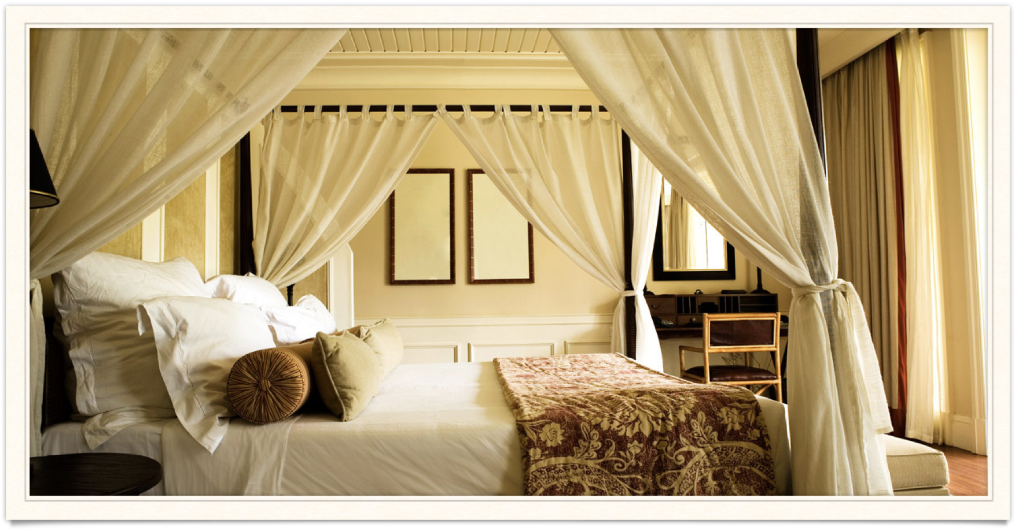

Exploratory Analysis
Youpele Michael

Slide 2
overview
Dataset
Exploratory Analysis
Hypothesis
Detected Seasonality
Lead time VS Cancellation

Slide 3
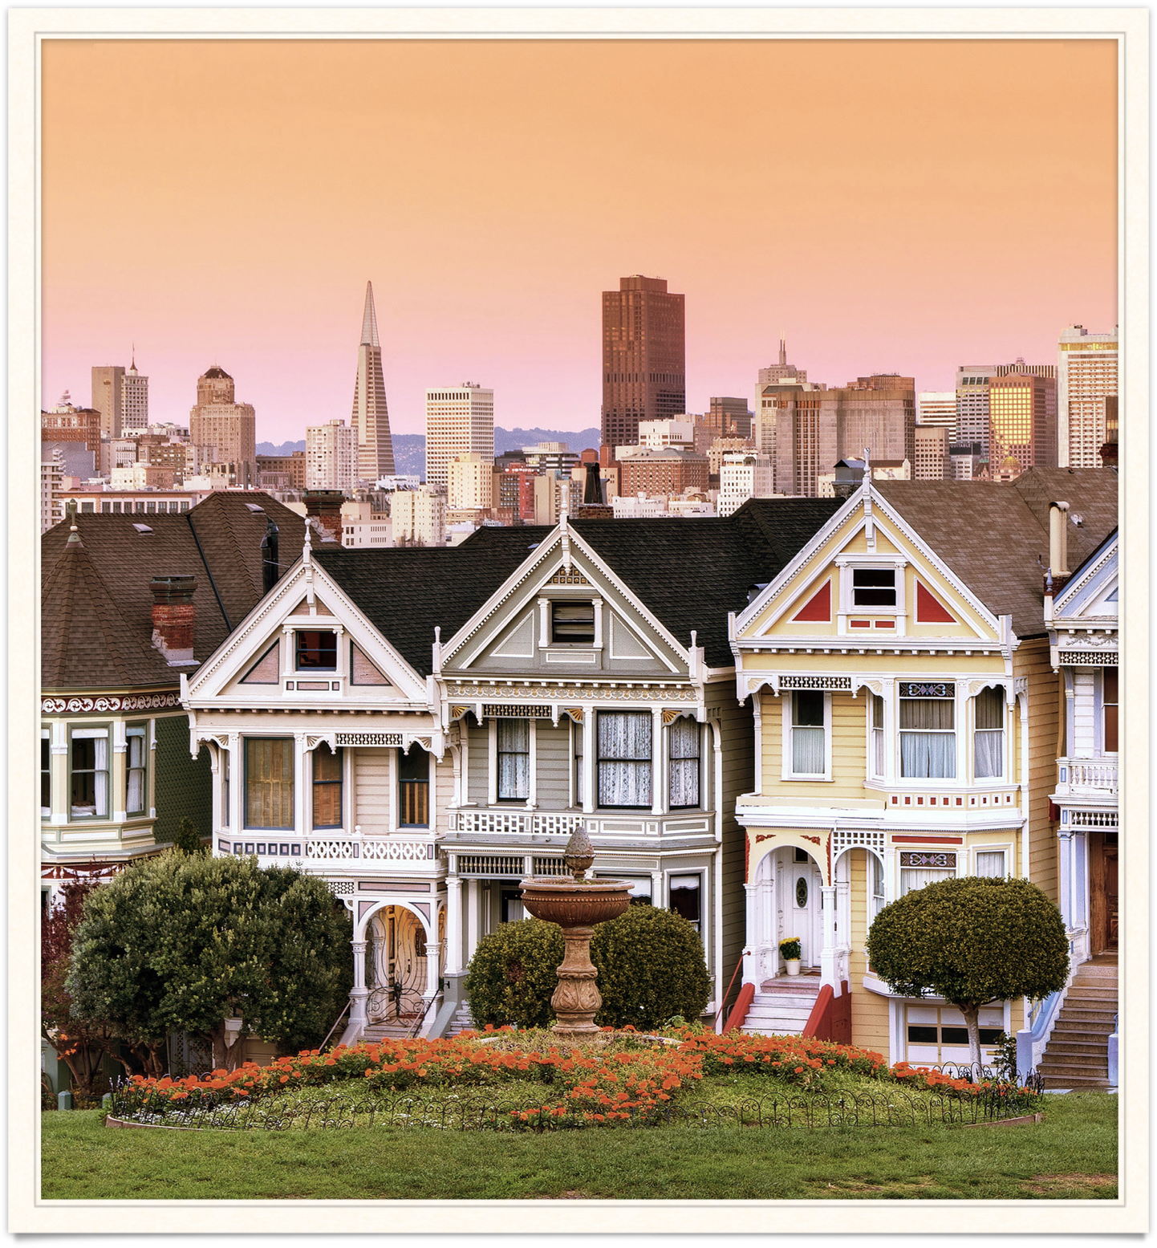
Dataset
Info
Cleaning

Slide 4
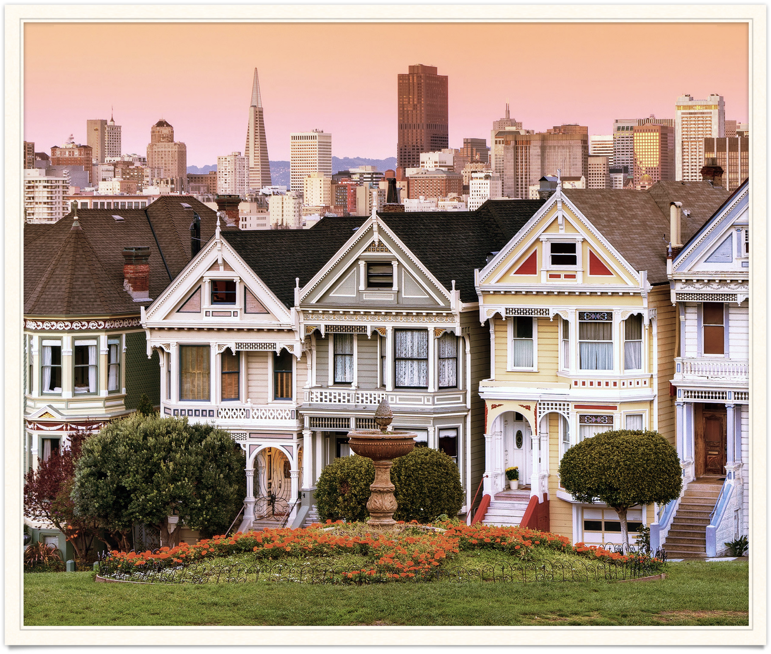

Dataset info
119,390 rows and 32 columns
Data types: integers, strings, dates, floats and null.
Columns:
hotel, is_canceled,
lead, time, arrival_date…,
meal, children, country,
number of booking changes,
customer type, reserved rom type,
parking space, reservation status etc

Slide 5
Dataset cleaning
129,425 null values where detected and replaced.
31,994 duplicate rows where detected and removed.

Slide 6
Exploratory Analysis
Hotel
Year & Month
Country
Meal
Distribution Channel
Customer type
Reserved Room type
Parking Spaces

Slide 7
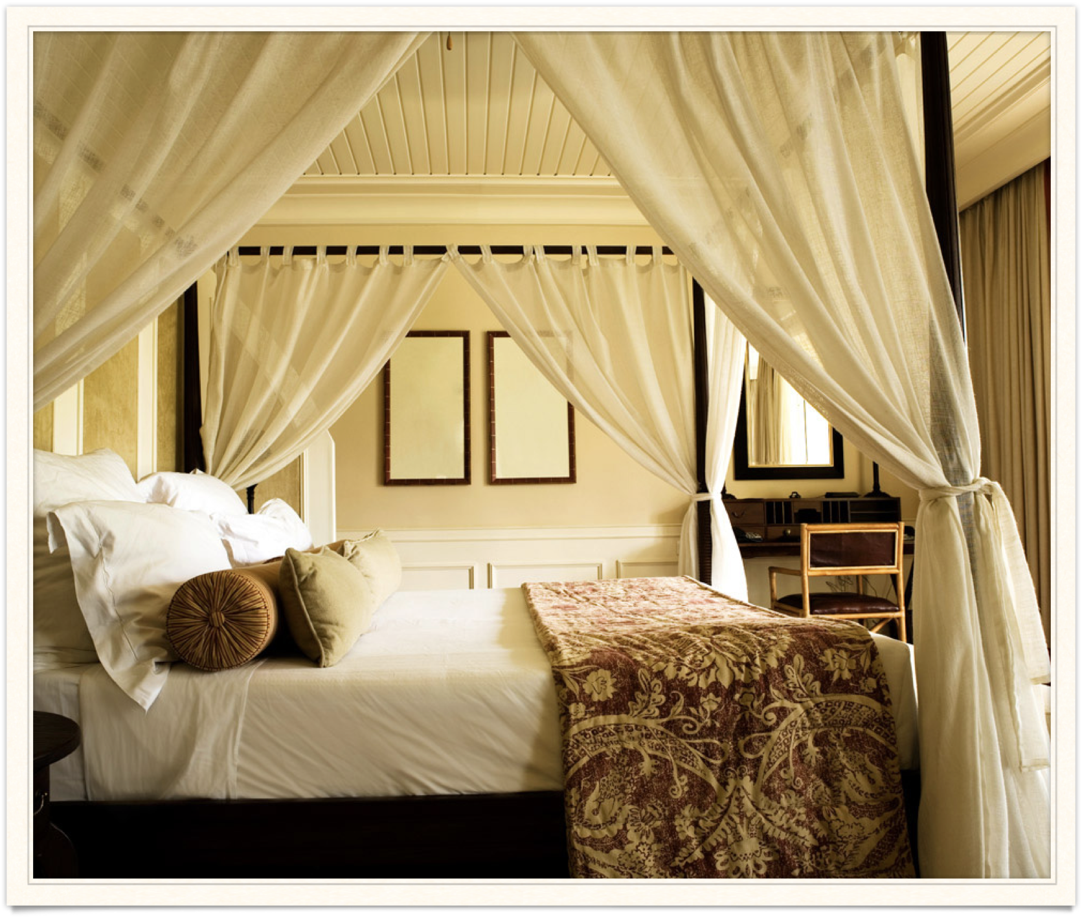
Exploratory Analysis: Hotel

Slide 8
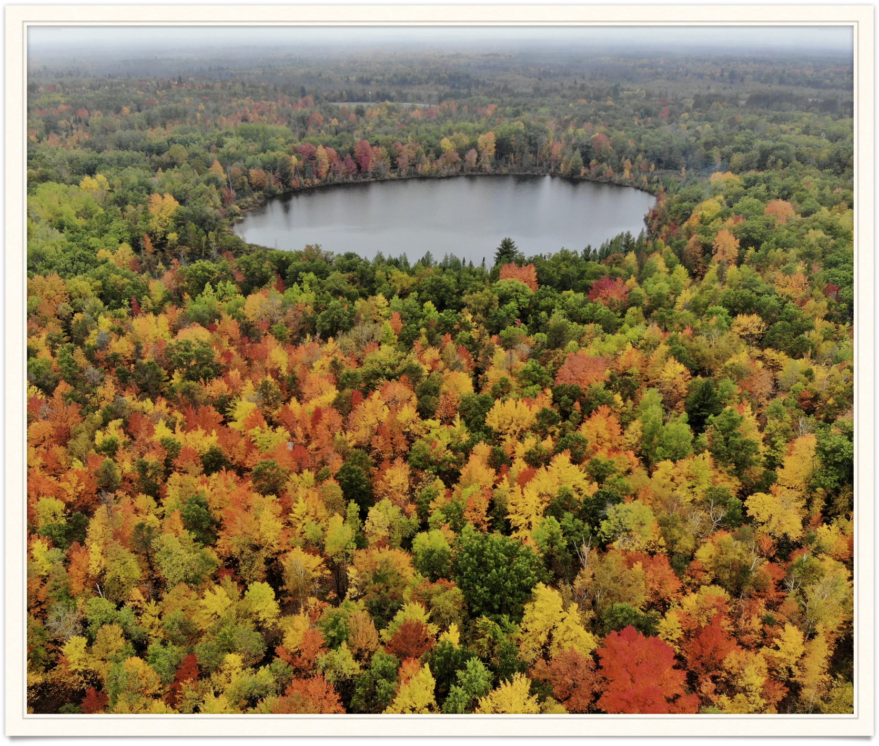
Exploratory Analysis: Year and month

Slide 9
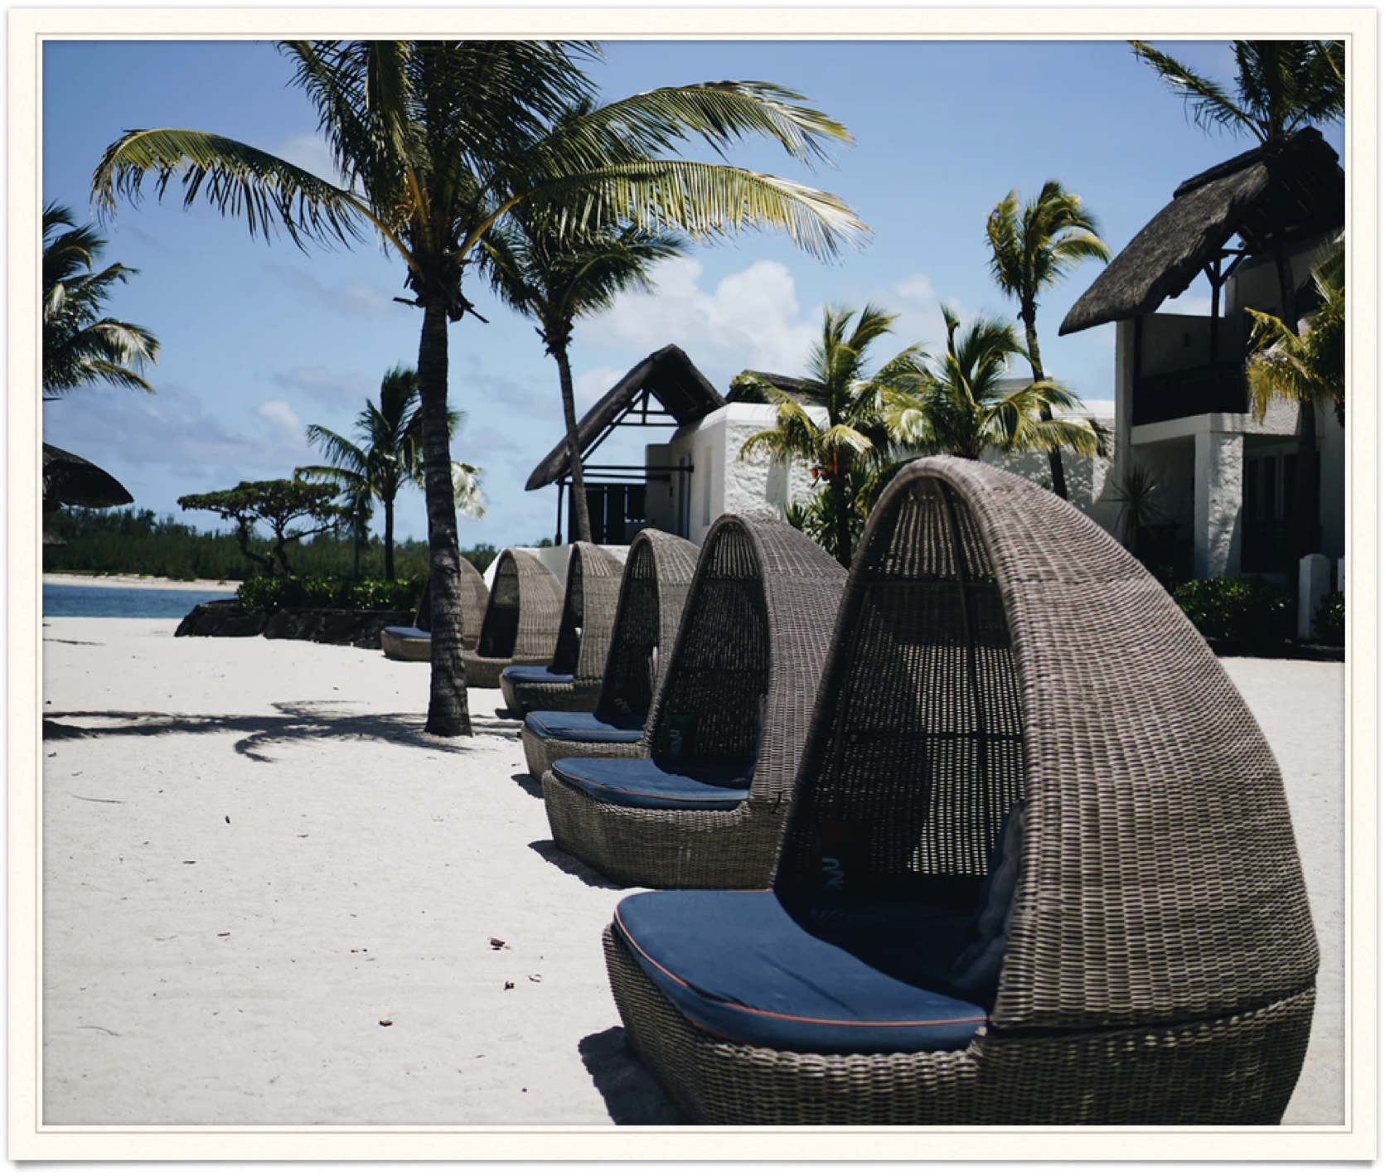
Exploratory Analysis: Year and month

Slide 10
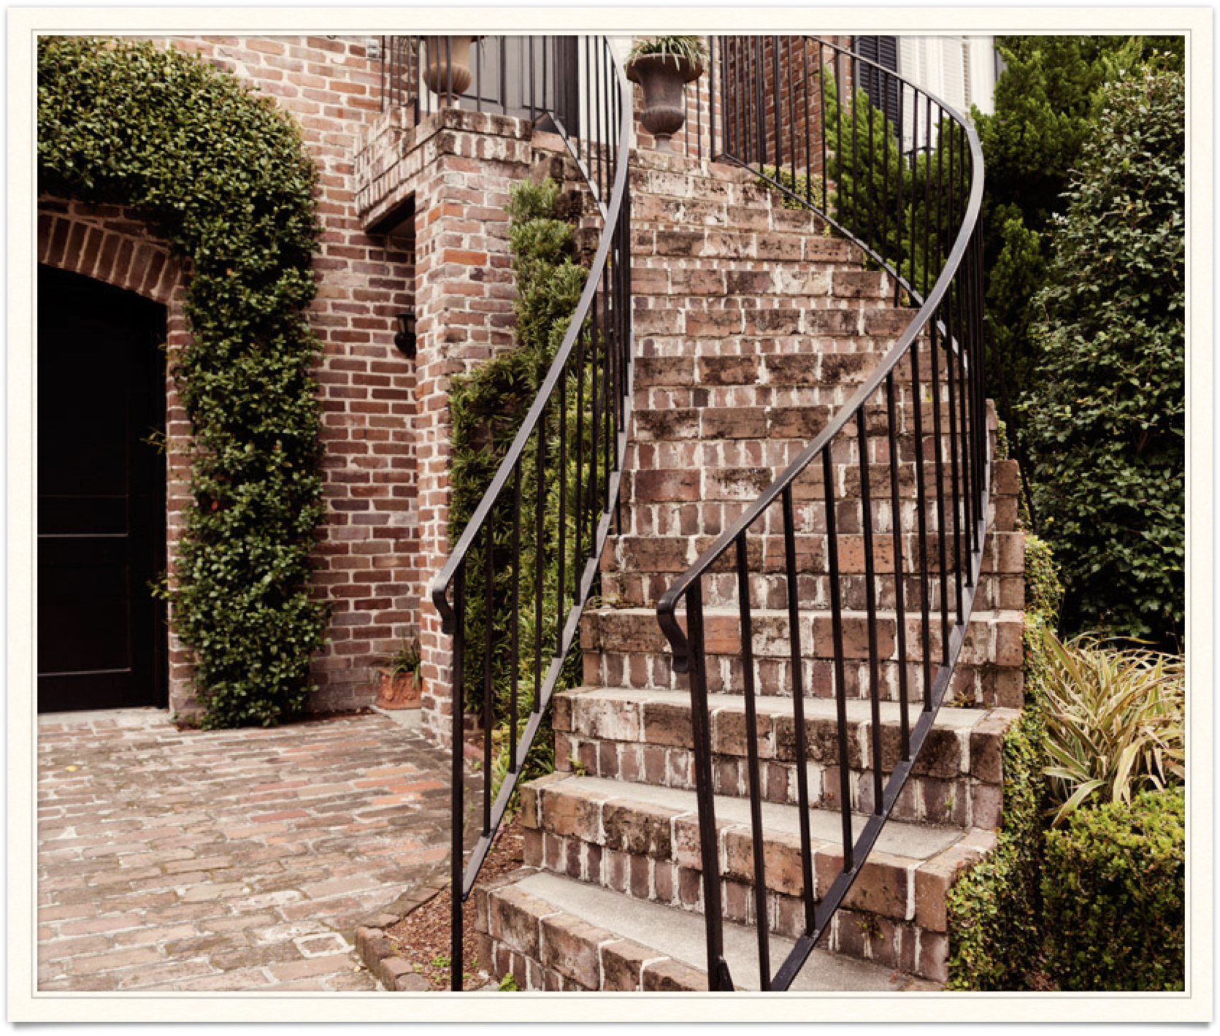
Exploratory Analysis: Year and month

Slide 11
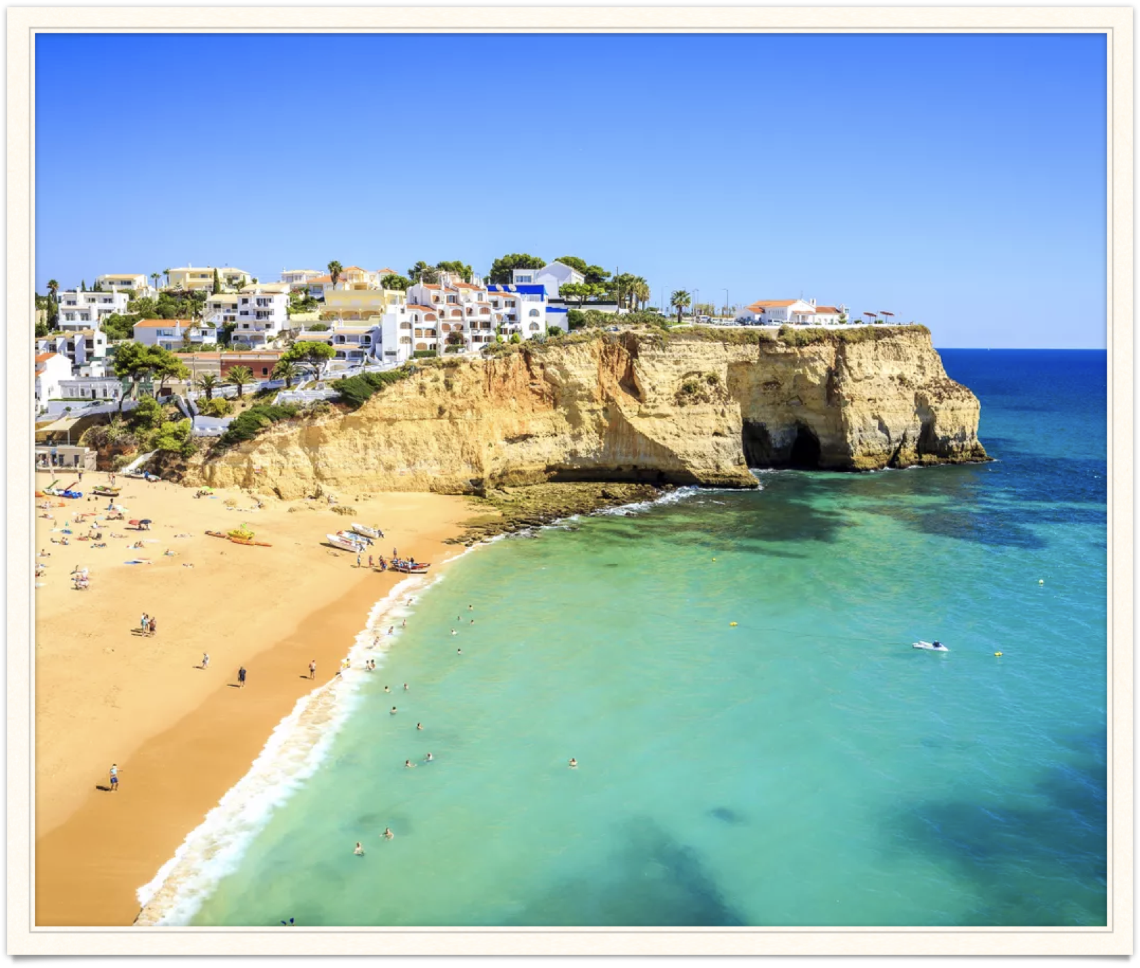
Exploratory Analysis: country

Slide 12
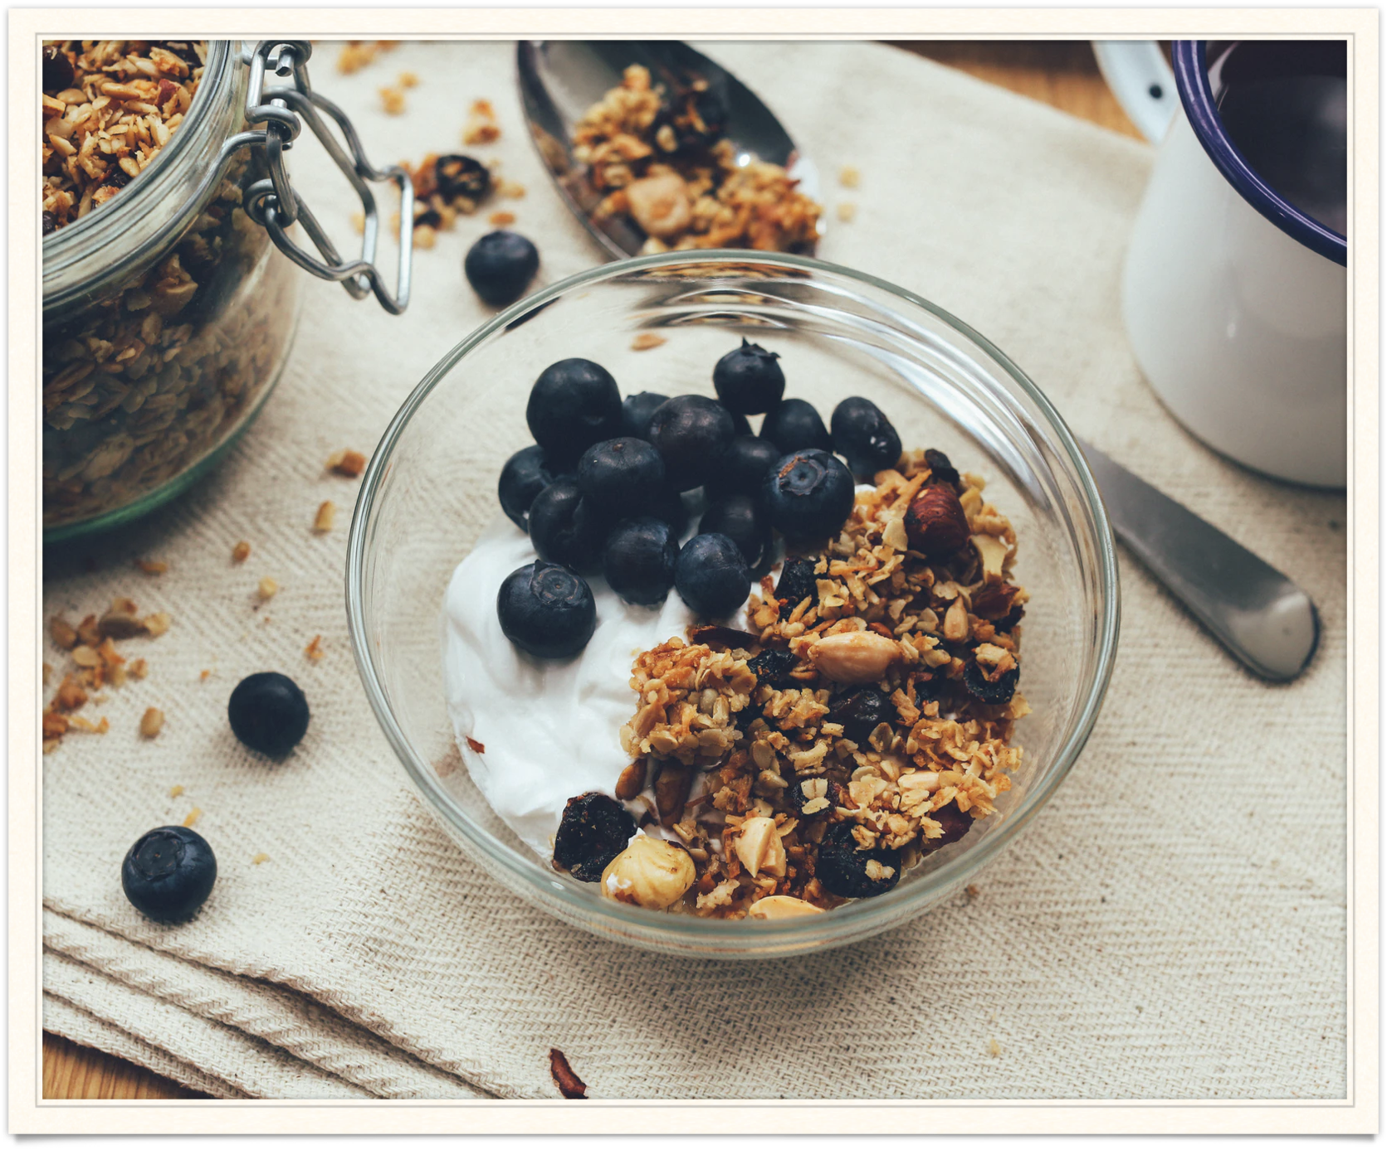
Exploratory Analysis: Meal

Slide 13
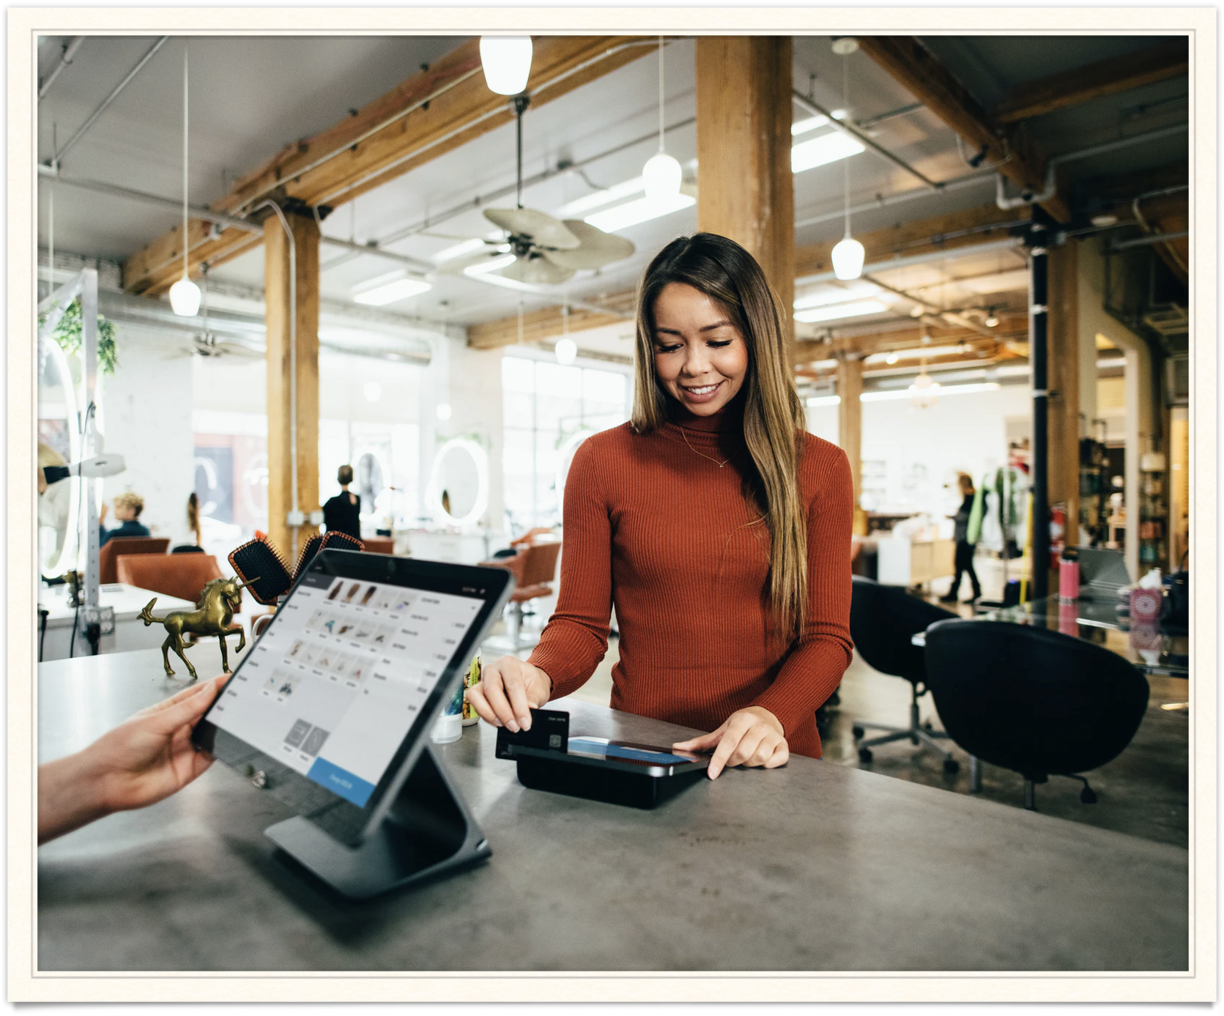
Exploratory Analysis: customer type

Slide 14
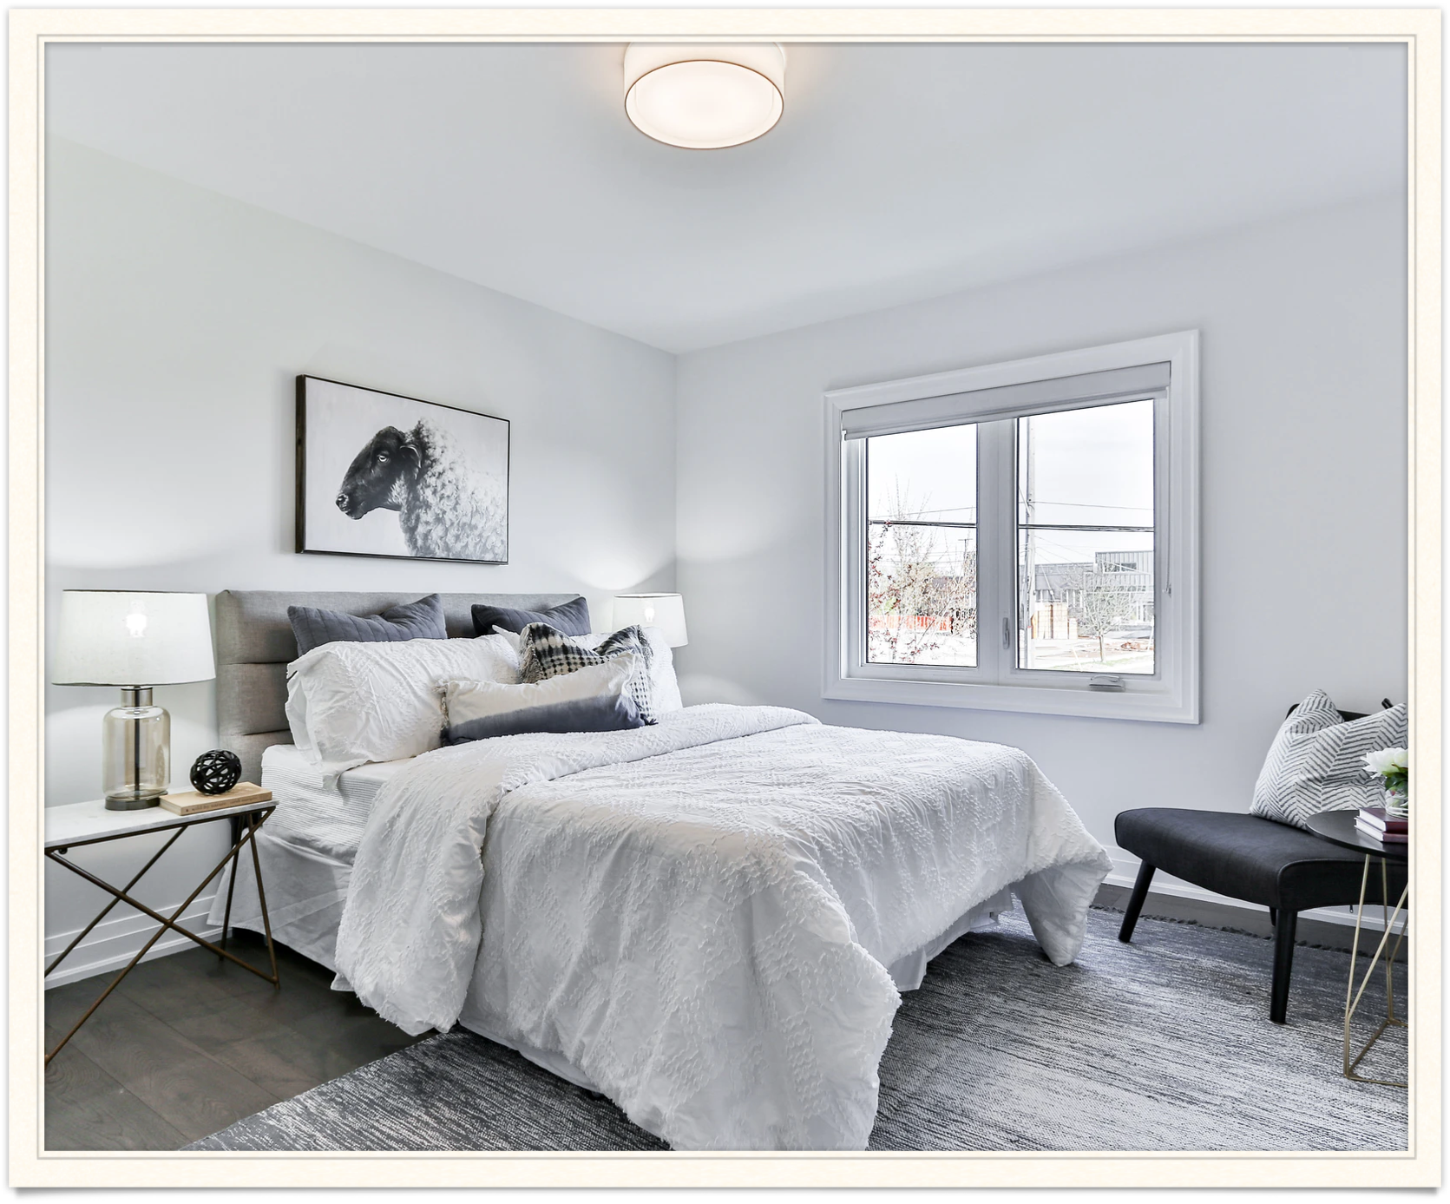
Exploratory Analysis: Reserved Room

Slide 15
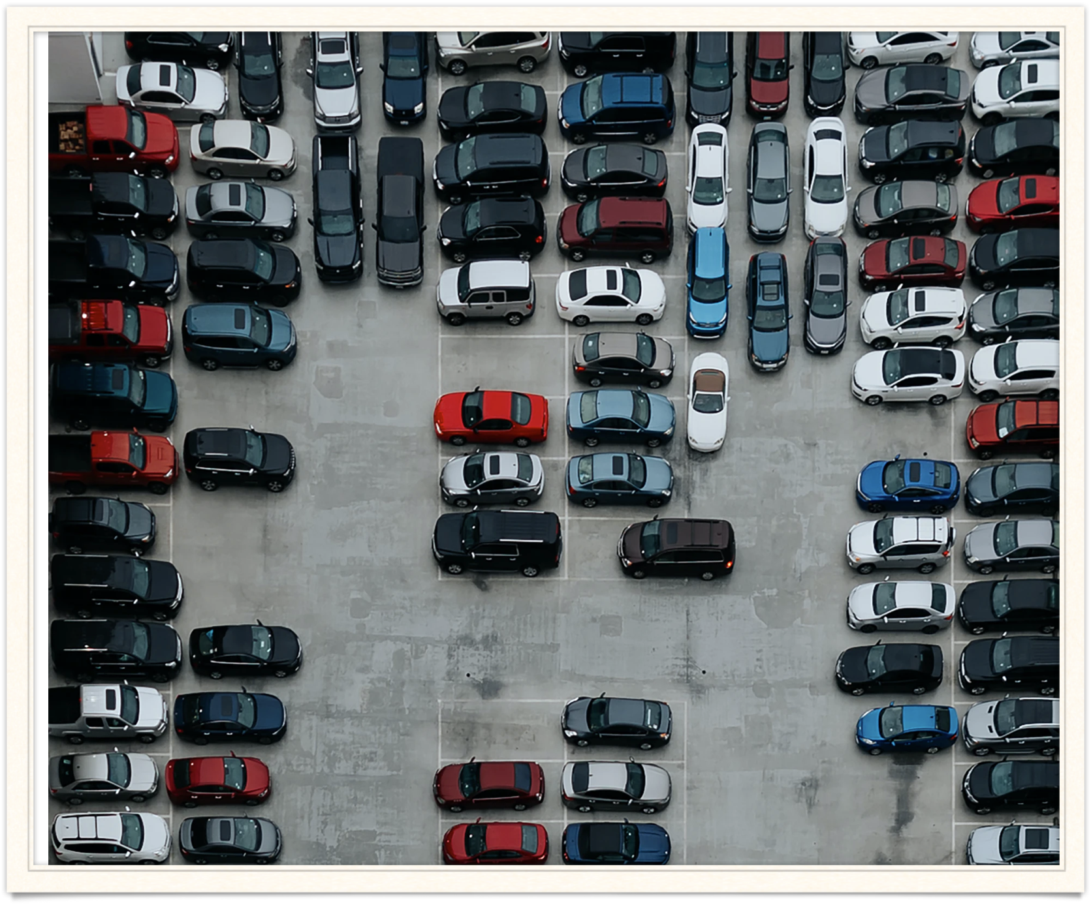
Exploratory Analysis: Parking spaces

Slide 16
Hypotheses
Hypothesis 1
Hypothesis 11

Slide 17
Hypothesis I
Portugal is the most visited country because:
The temperature, [1-3]
Proximity to the sea…, beaches,
Hotel cost,
Cost of living,
Population density,
Tourism policy, etc [4]

Slide 18
Hypothesis II
Majority of the reservation include breakfast because:
Breakfast is the most important meal of the day [5-6]

Slide 19
Seasonality

Slide 20
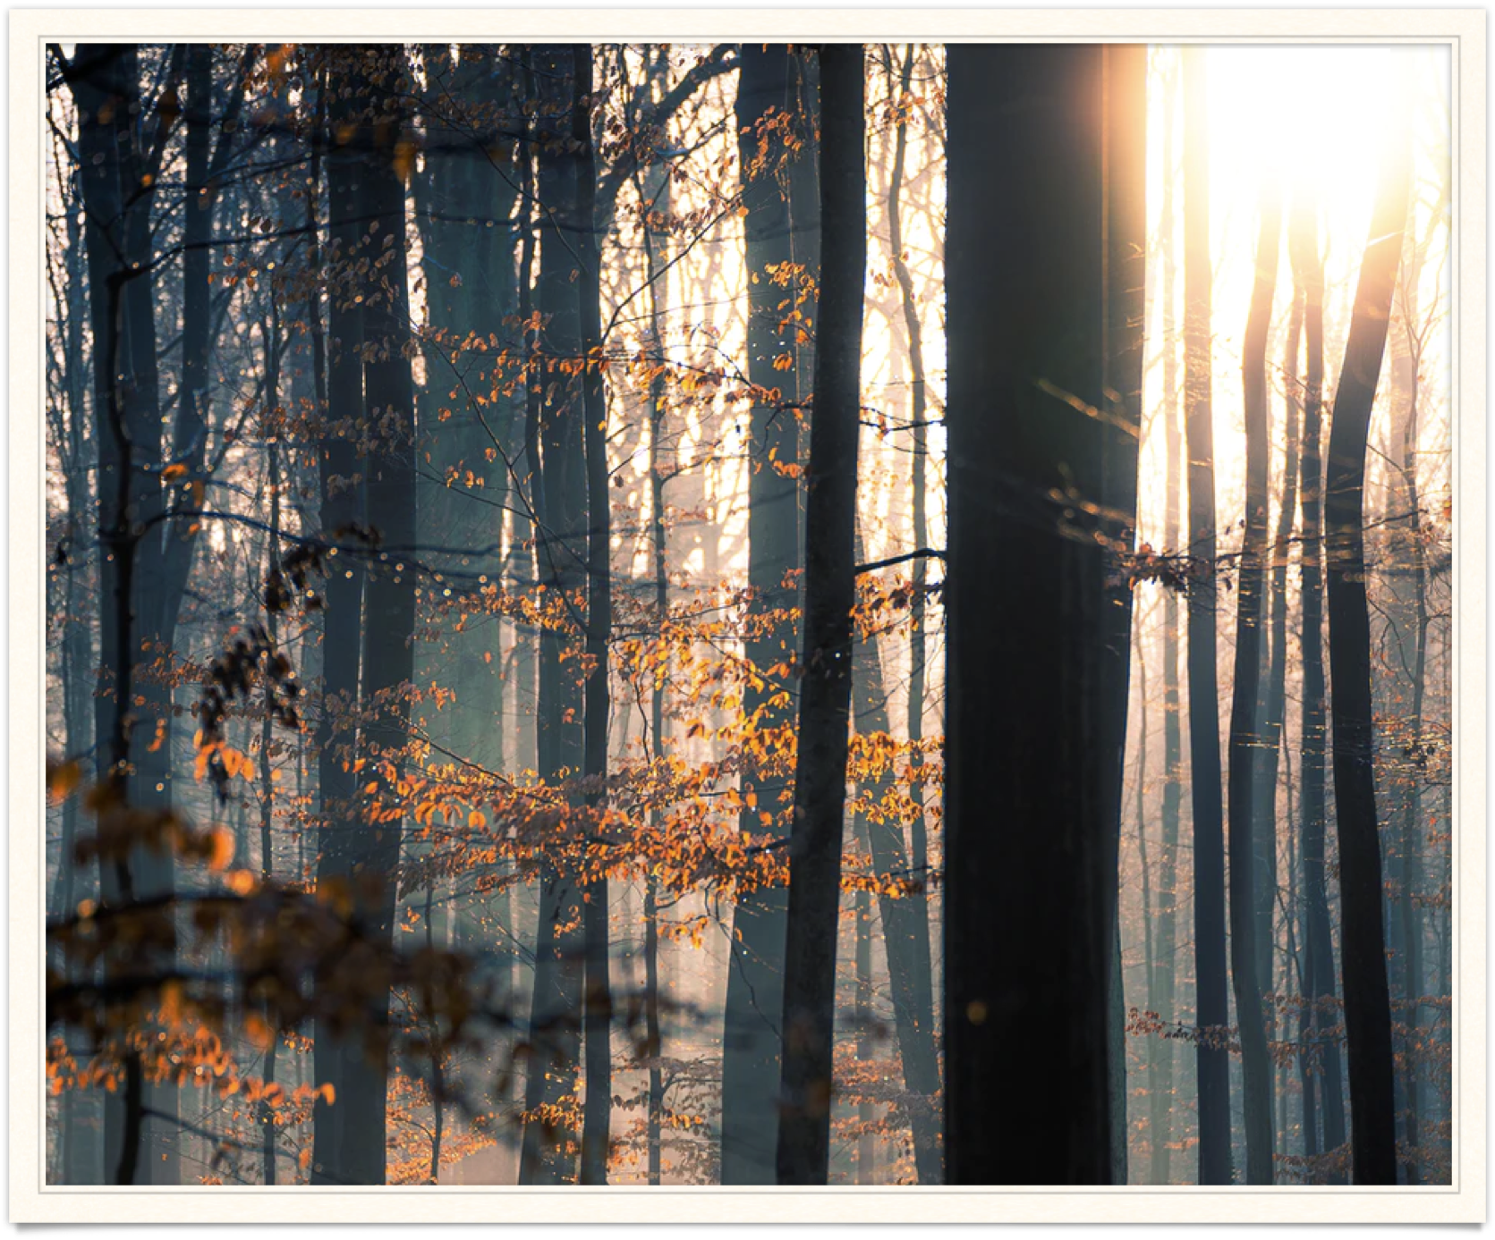
Seasonality
Hypothesis I already indicates seasonality, why people travel to Portugal.
Historically, there are more reservations/travels/touristic activities in the summer that any other season.

Slide 21
Seasonality
Autumn & Winter had the least reservation.
Reservations started increasing in the spring as the temperature gets warmer.

Slide 22
Lead time
VS Cancellation

Slide 23
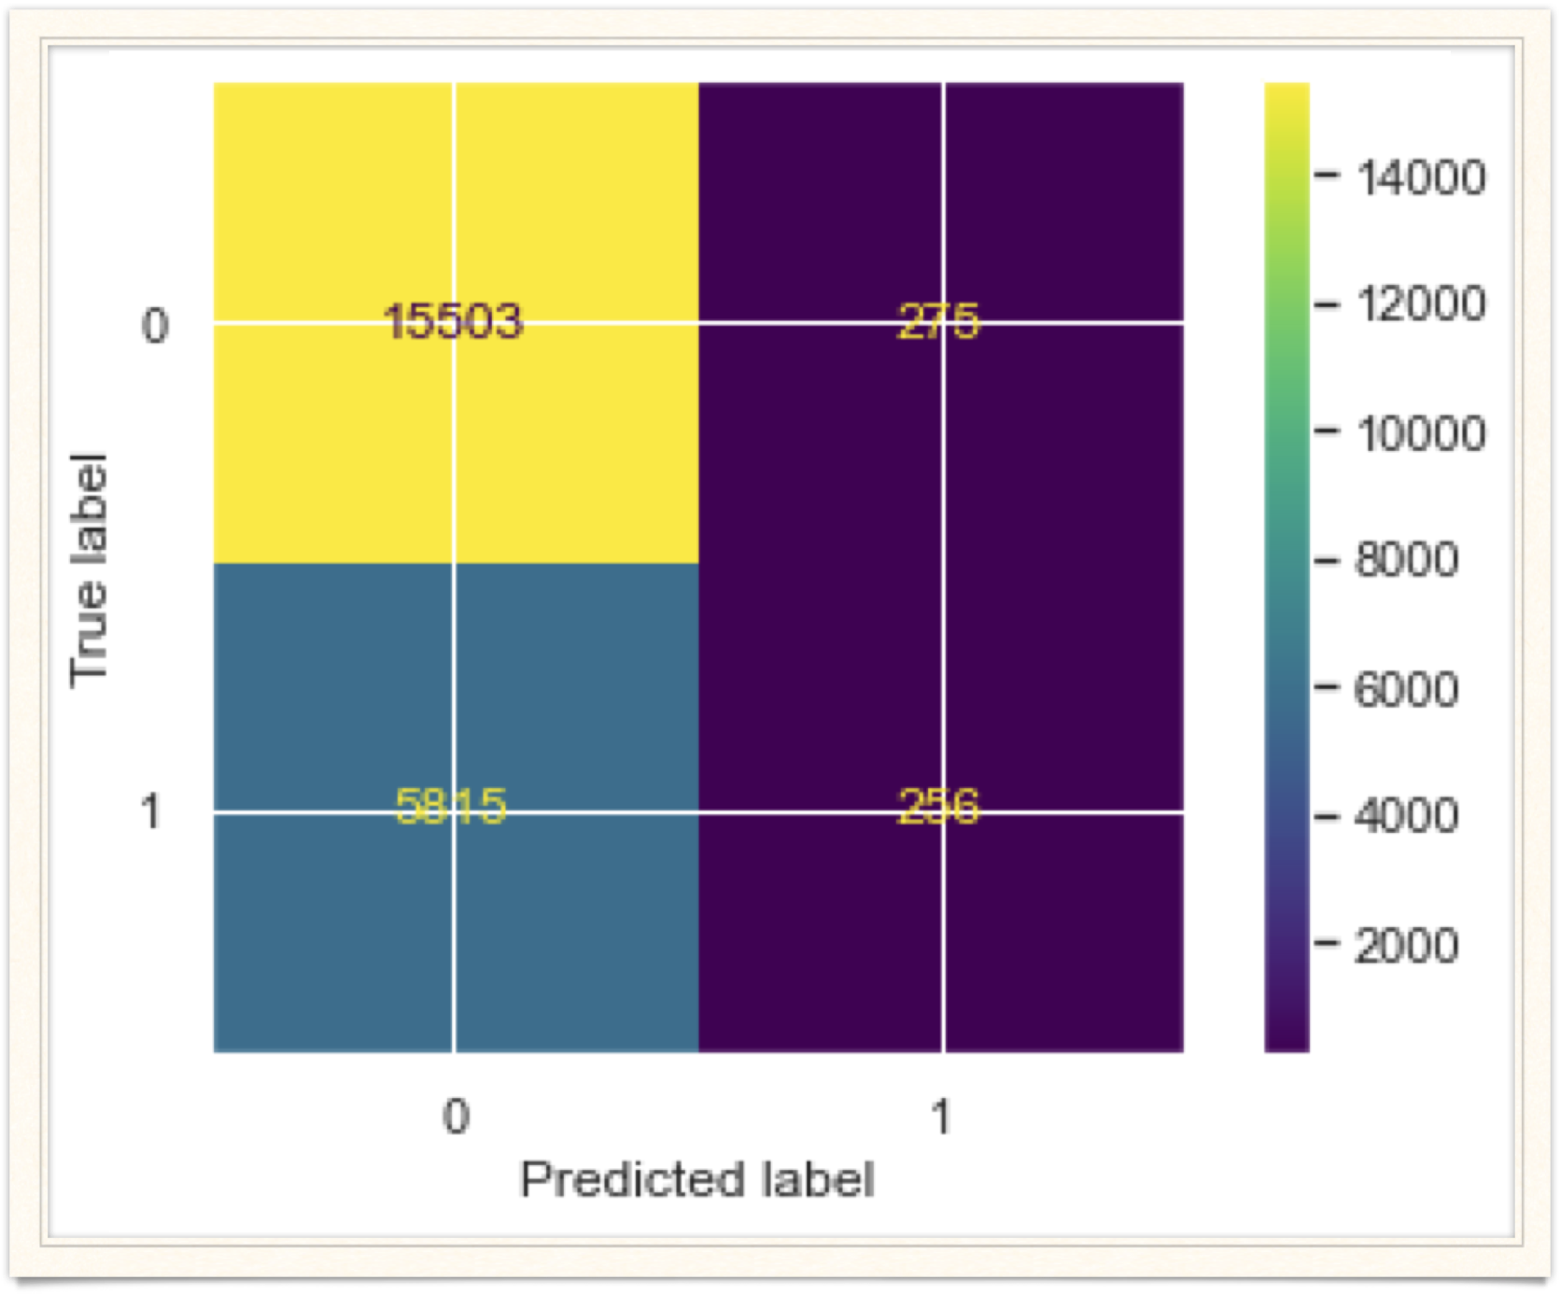
Lead time
VS
Cancellation
Built ML model that predicts whether a customer their will cancel reservation given the lead time. (Accuracy = 0.72)
The higher the lead time the more probable that the customer will cancel their booking.

Slide 24
“Thank you for your audience.”
–Youpele Michael

Slide 25
References
Holiday Weather, Algarve, Portugal: Annual Weather Averages. https://www.holiday-weather.com/algarve/averages/
Holiday Weather, London, United Kingdom: Annual Weather Averages. https://www.holiday-weather.com/london/averages/
The Portugal News, Portugal’s €7bn climate change bill, 2017. https://www.theportugalnews.com/news/portugals-7bn-climate-change-bill/40860#:~:text=In%20terms%20of%20the%20effects,by%20temperatures%20reached%20in%201989
Almeida García, Fernando & Macias, Rafael & Balbuena, Antonia. (2015). Tourist Spaces and Tourism Policy in Spain and Portugal. International Journal of Culture Tourism and Hospitality Research. 10. 235-249. 10.1108/S1871-317320150000010017.
Charles Spence, Breakfast: The most important meal of the day?, International Journal of Gastronomy and Food Science, Volume 8, 2017, Pages 1-6, ISSN 1878-450X, https://doi.org/10.1016/j.ijgfs.2017.01.003.
Benton et al., 2001 D. Benton, O. Slater, R.T. Donohoe The influence of breakfast and a snack on psychological functioning Physiol. Behav., 74 (2001), pp. 559-571

